Slide 1

Customer Behavior and Purchase Pattern Analysis for E-Commerce
Prepared by: Vaibhav Maruti Gurav
Date: 2nd October 2025

Slide 2



Introduction: Unlocking E-commerce Growth
Objective
Our goal is to understand customer purchase patterns, evaluate product performance, and refine retention strategies to drive sustained growth.
Dataset Overview
This analysis leverages comprehensive data from multiple sources including Customer profiles, Order history, Product catalog, Browsing behavior, and customer Feedback.

Slide 3

Methodology: Data-Driven Insights
Data Sources
Customer Profiles
Order Transactions
Product Information
Browsing History
Customer Feedback
Key Metrics
Total Revenue
Order Frequency
Customer Lifetime Value (CLV)
Conversion Rate
Product Ratings

Slide 4

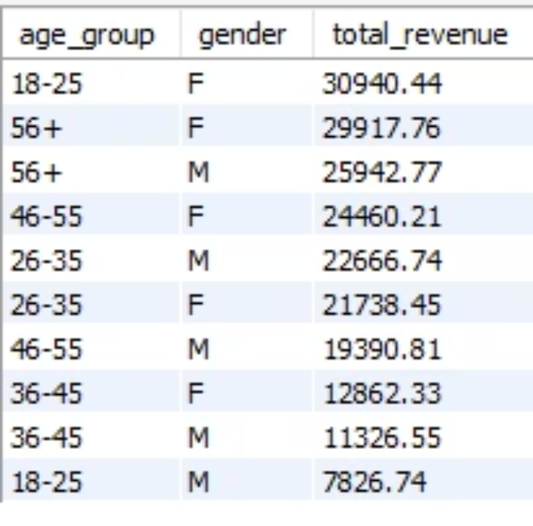
Analysis 1: Age and Gender Revenue Contribution
Which age group contributes the highest revenue, and how does gender distribution affect purchase behavior?
By identifying top-earning age groups and understanding gender-specific purchase trends, we can tailor marketing campaigns for maximum impact and personalization.

Slide 5

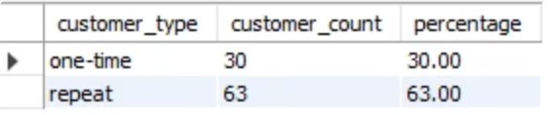
Analysis 2: Repeat vs. One-Time Buyers
What percentage of customers place multiple orders versus those who shop only once?
Understanding the ratio of repeat buyers to one-time purchasers is crucial for assessing customer retention and identifying opportunities to convert single-purchase customers into loyal advocates.

Slide 6

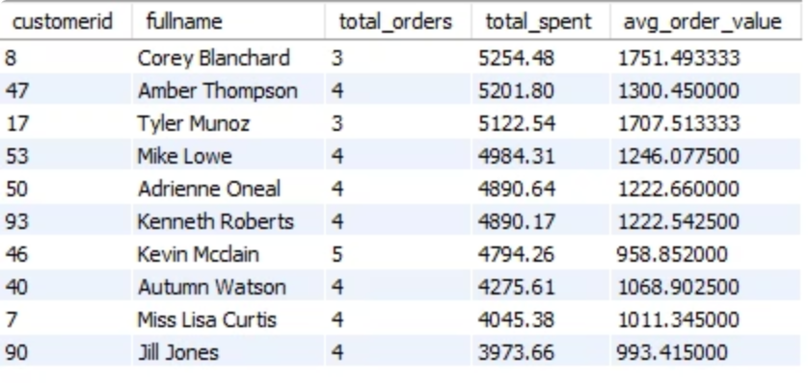
Analysis 3: Identifying VIP Customers
Who are the top 10 customers by total spending, and what is their average order frequency?
Pinpointing our highest-spending customers allows us to develop exclusive loyalty programs and personalized marketing strategies to reward their dedication and encourage continued engagement.

Slide 7

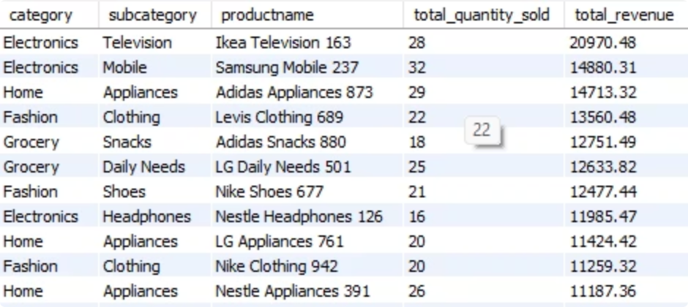
Analysis 4: Top-Selling Products and Categories
Which products and categories generate the highest sales volume and revenue?
Highlighting our best-performing products and categories provides valuable insights for optimizing inventory management, enhancing promotional efforts, and guiding future product development.

Slide 8

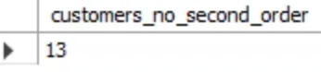
Analysis 5: New Customer Churn Risk
How many customers who registered in the last 12 months did not place a second order?
Identifying new customers who are at risk of churning after their first purchase enables us to implement targeted retention campaigns, such as personalized offers or follow-up communications, to encourage repeat business.

Slide 9

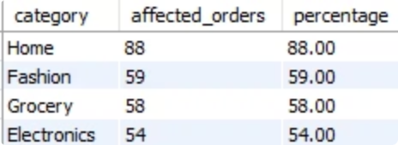
Analysis 6: Order Cancellations and Returns
What percentage of orders are canceled or returned, and which product categories are most affected?
Monitoring problem categories with high cancellation or return rates is essential for identifying underlying issues, whether it's product quality, inaccurate descriptions, or delivery problems, and implementing corrective actions.

Slide 10

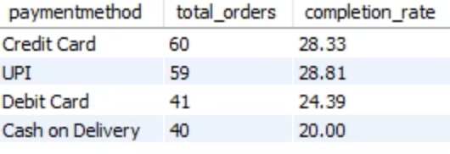
Analysis 7: Payment Method Popularity and Success
Which payment methods are most popular, and how do they relate to order success/failure rates?
Determining preferred payment methods and their effectiveness in completing transactions helps optimize the checkout process, reduce cart abandonment, and ensure a seamless customer experience.

Slide 11

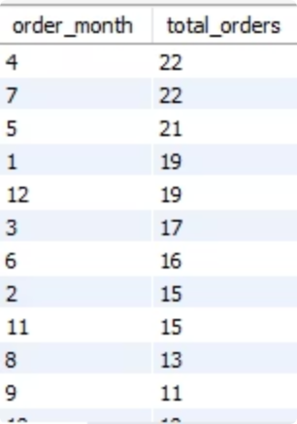
Analysis 8: Seasonal Peaks and Browsing Behavior
Understanding which months or seasons drive the highest order volume and whether browsing activity significantly increases before major sales events is crucial for optimizing our promotional strategies.
Insight: Identify seasonal trends to plan targeted promotions and sales events, maximizing conversion during peak interest periods.

Slide 12

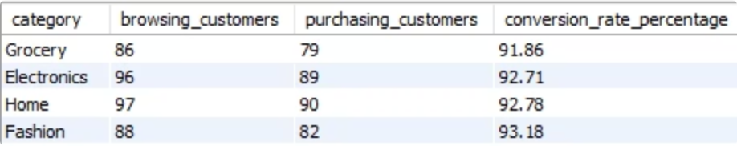
Analysis 9: Bridging the Gap from Browse to Buy
Identifying Unconverted Browsers and Low-Performing Categories
This analysis reveals the number of customers who browsed products but did not proceed to purchase, along with identifying product categories that consistently exhibit the lowest conversion rates. Understanding these metrics is vital for improving user experience and sales.
Insight: Pinpoint low-conversion categories to refine product pages, enhance offers, or provide clearer product information, turning browsers into buyers.

Slide 13

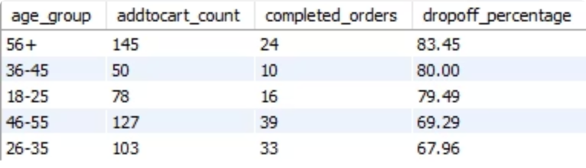
Analysis 10: Tackling Cart Abandonment
Understanding Drop-Off Points in the Purchase Funnel
This analysis quantifies the percentage of 'Add to Cart' actions that do not result in completed purchases and identifies specific customer segments with the highest cart abandonment rates. This information is key to recovering lost sales and improving the checkout process.
Insight: Highlight customer segments with high cart abandonment to implement targeted re-engagement strategies, such as personalized follow-up emails or special offers.

Slide 14

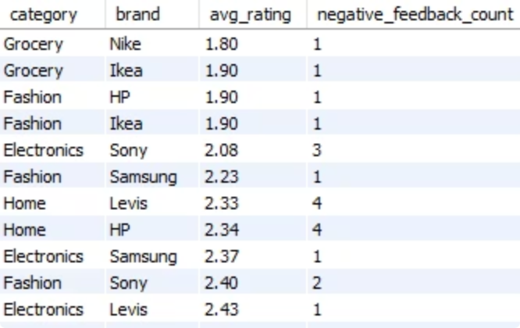
Analysis 11: Elevating Product and Brand Perception
Gauging Customer Satisfaction by Category and Brand
By calculating the average product rating per category and identifying brands that consistently receive negative feedback, we can gain valuable insights into product quality and customer satisfaction. This data drives continuous improvement.
Insight: Understand brand and category performance directly from customer feedback to guide quality improvements, product development, and supplier negotiations.

Slide 15

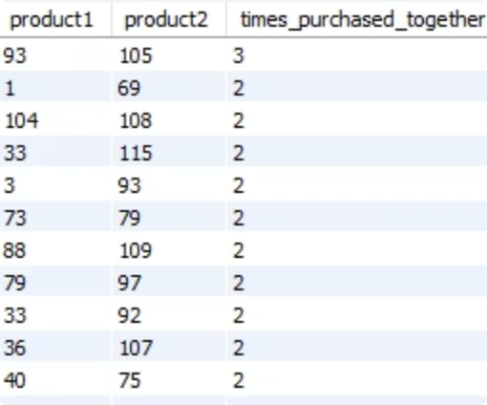
Analysis 12: Maximizing Sales Through Product Bundling
Discovering Cross-Selling Opportunities
This analysis pinpoints products that are frequently purchased together, providing a clear roadmap for creating attractive bundle offers. Leveraging these insights can significantly boost average order value and enhance the customer shopping experience.
Insight: Detect natural cross-selling opportunities to create strategic product bundles, increasing sales and customer satisfaction through curated offerings.

Slide 16

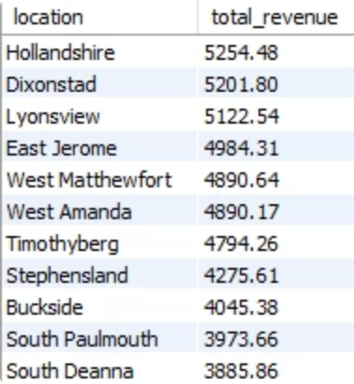
Analysis 13: Geo-Targeting for Optimal Marketing ROI
Identifying High-Revenue Geographic Areas
By analyzing revenue generation across different locations and cities, we can identify our strongest markets. This intelligence is critical for focusing marketing efforts where they will yield the greatest return.
Insight: Concentrate marketing campaigns in top-revenue locations to maximize return on investment (ROI) and deepen market penetration.

Slide 17

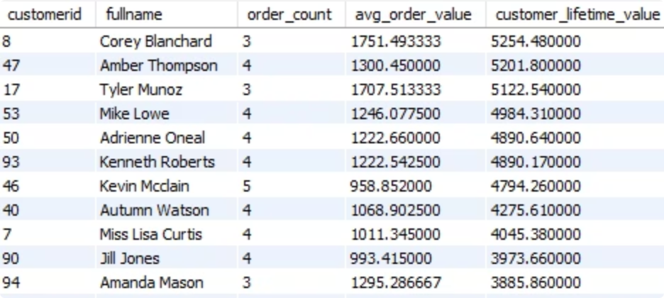
Analysis 14: Cultivating Long-Term Customer Value
Predicting Customer Lifetime Value (CLV)
By examining order frequency and average spend, we can accurately predict which customers are most likely to become long-term valuable assets. This allows for proactive engagement and tailored loyalty programs.
Insight: Identify high Customer Lifetime Value (CLV) customers for enrollment in exclusive loyalty programs and personalized marketing initiatives, fostering lasting relationships.

Slide 18

Summary & Strategic Recommendations
Optimized Targeting
Top age groups, products, and locations have been identified, enabling precision marketing.
Enhanced Retention
Implement tailored retention and loyalty strategies for high-CLV customers.
Increased AOV
Leverage identified cross-selling and bundling opportunities to boost average order value.
Efficient Operations
Strategic stock management and promotion planning based on seasonal trends.

Slide 19

Thank you!
We appreciate your time and attention to this comprehensive analysis. We look forward to discussing these insights further and collaborating on future strategies to drive exceptional e-commerce growth.

